Slide 1
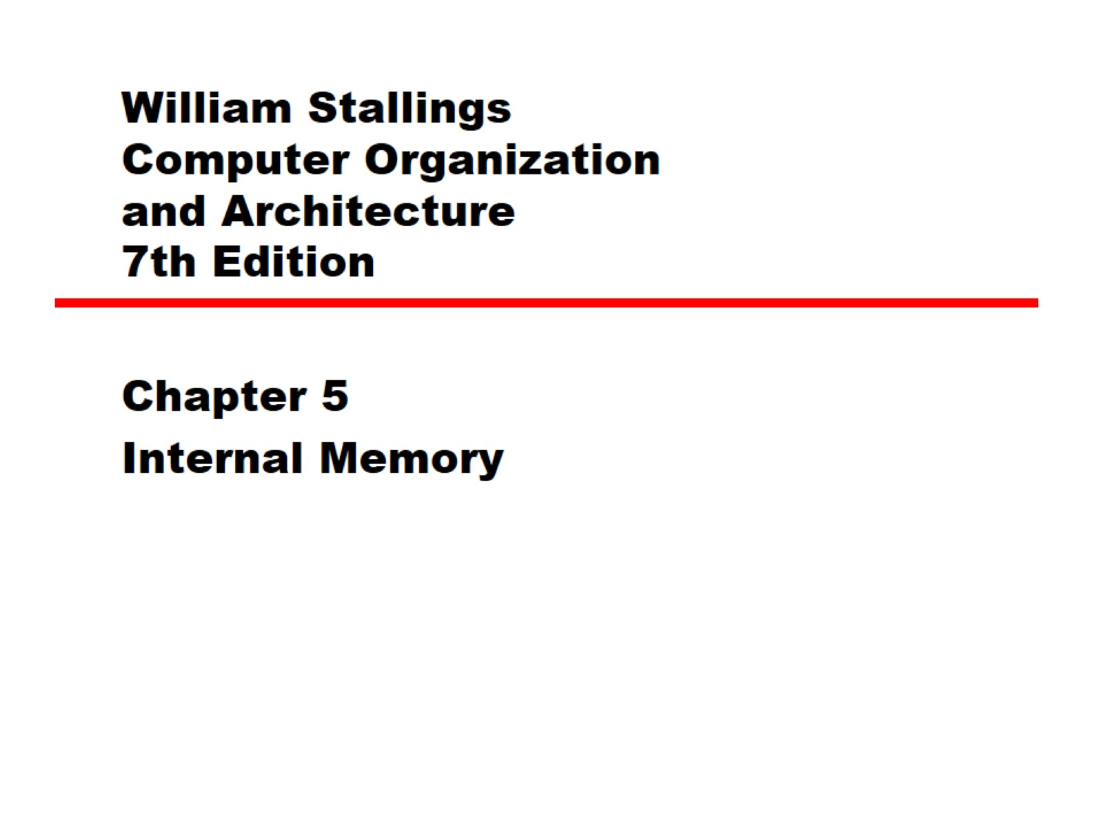
William Stallings Computer Organization and Architecture 7th Edition

Slide 2
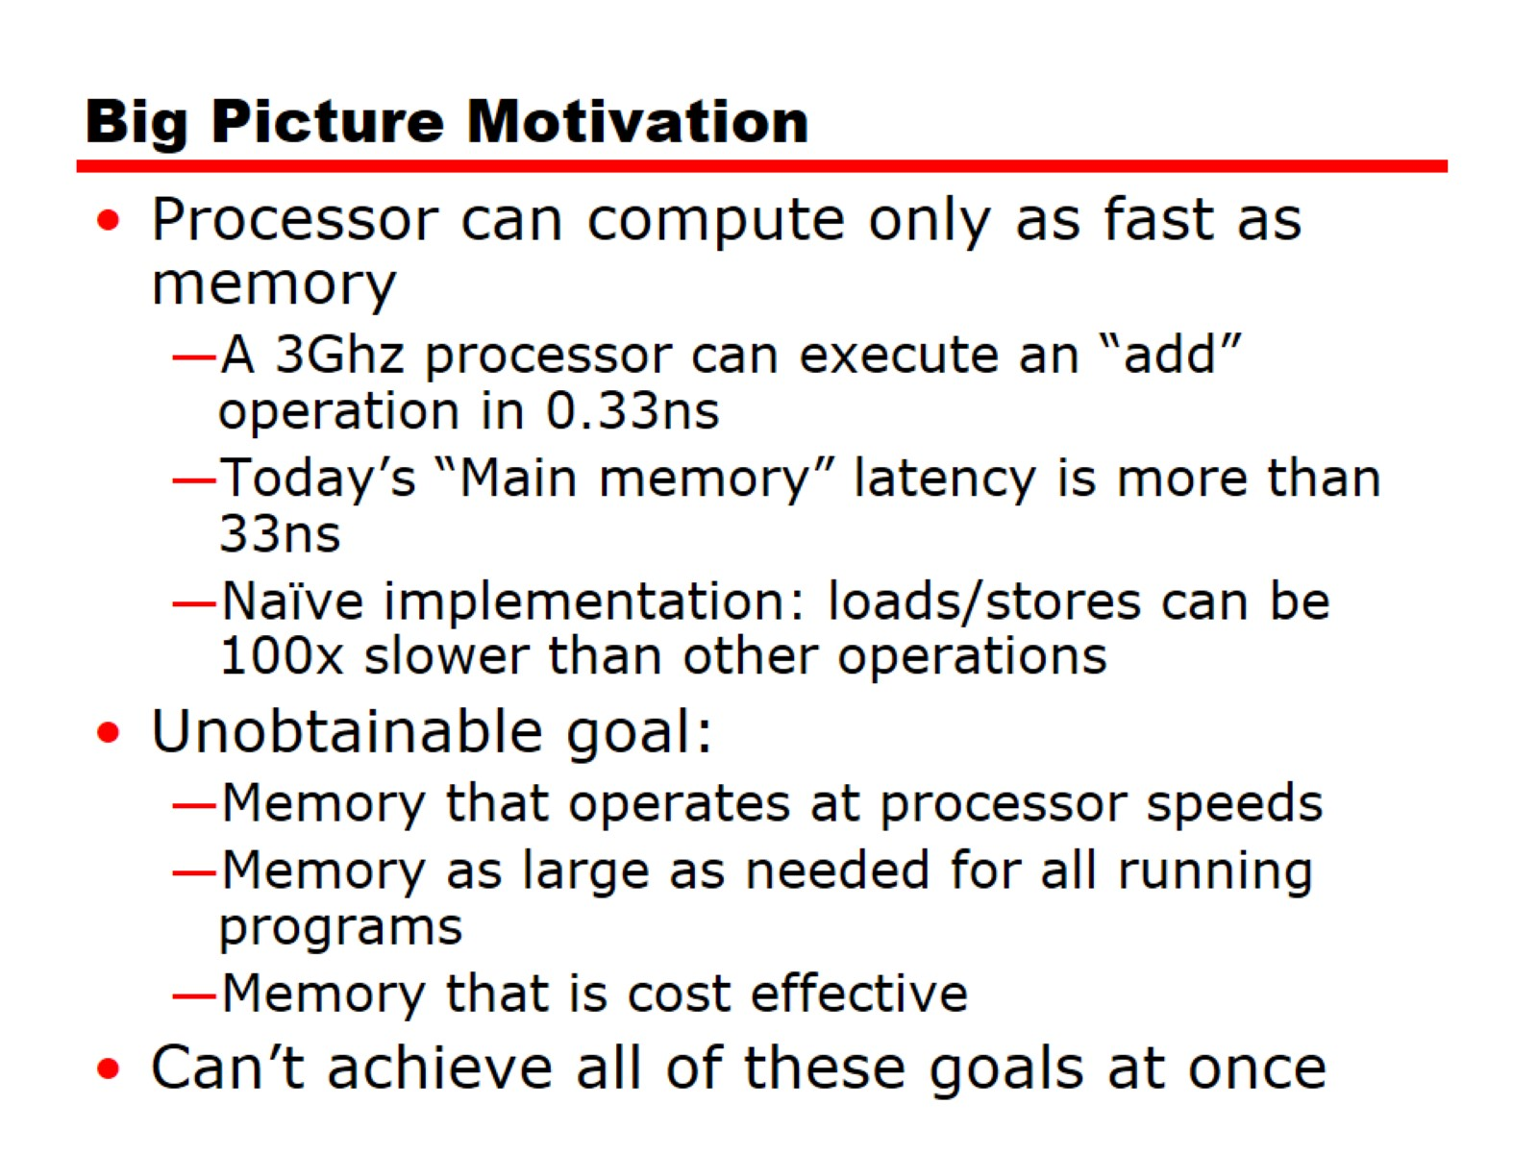
Big Picture Motivation

Slide 3
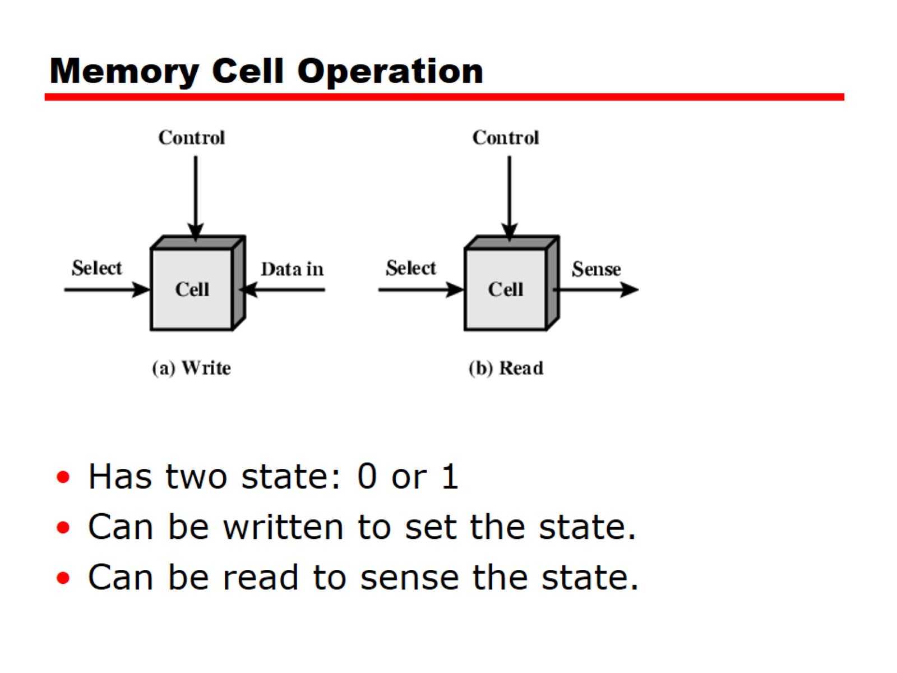
Memory Cell Operation

Slide 4
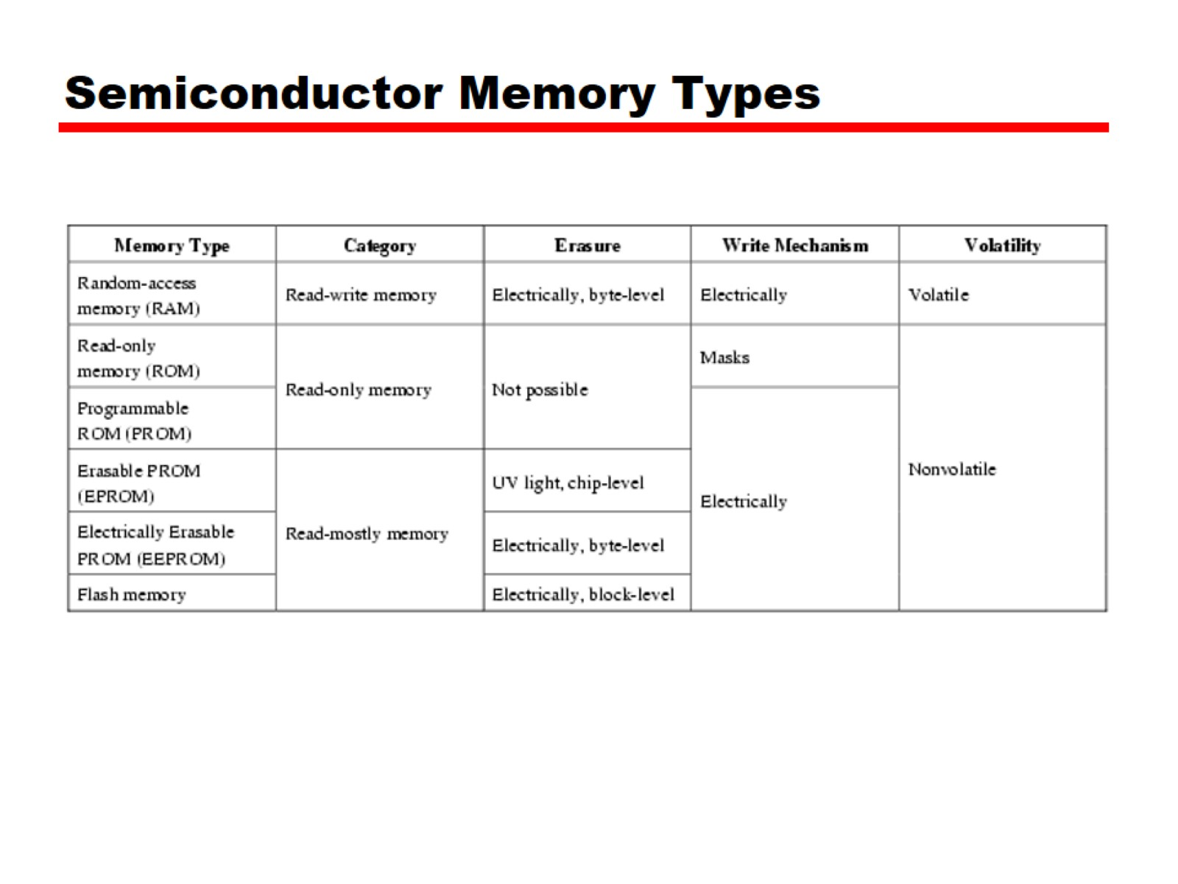
Semiconductor Memory Types

Slide 5
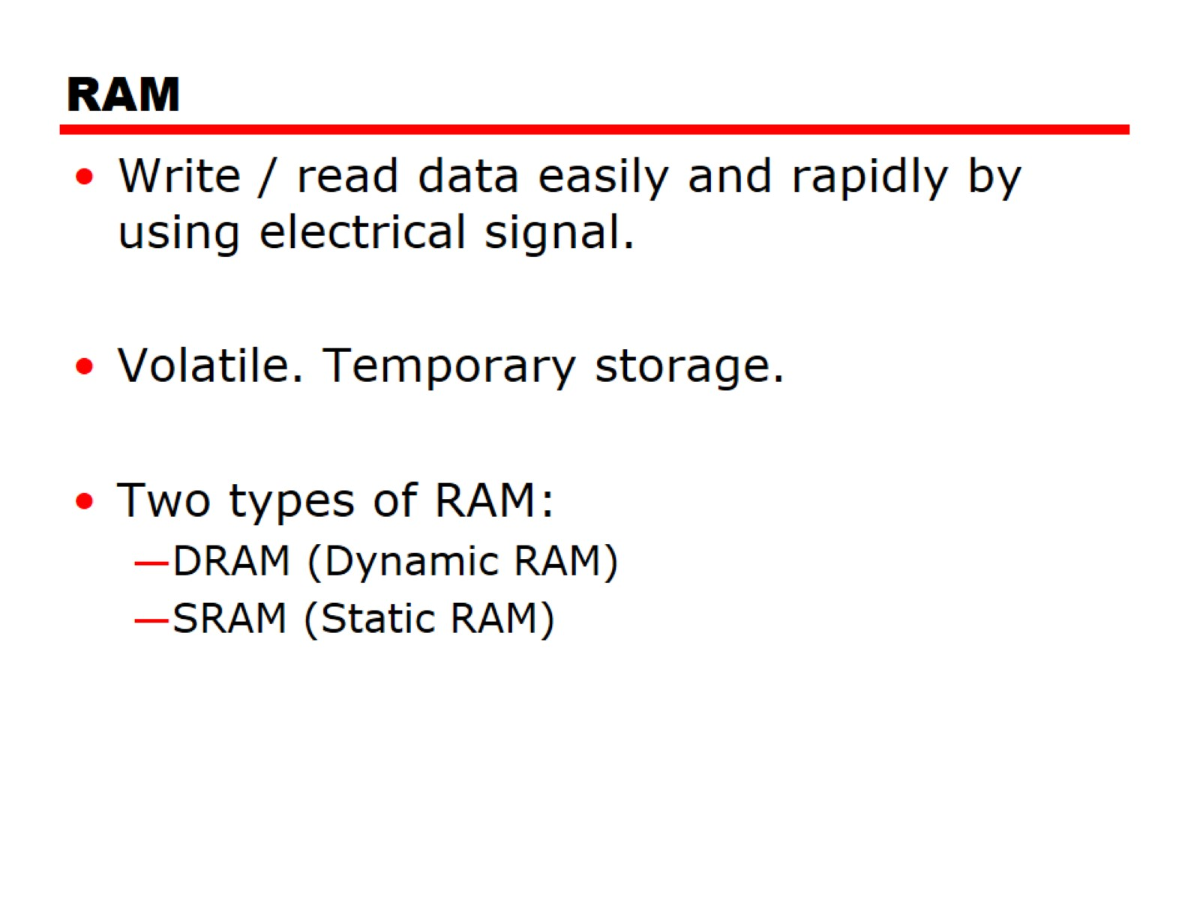
RAM

Slide 6
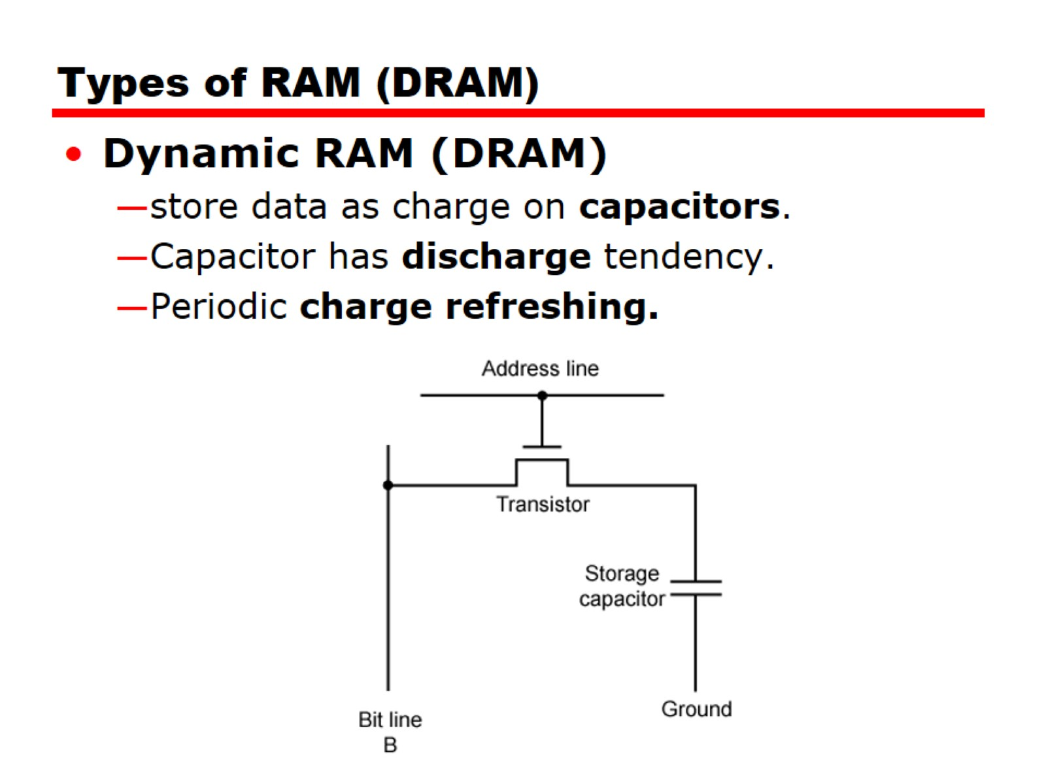
Types of RAM (DRAM)

Slide 7
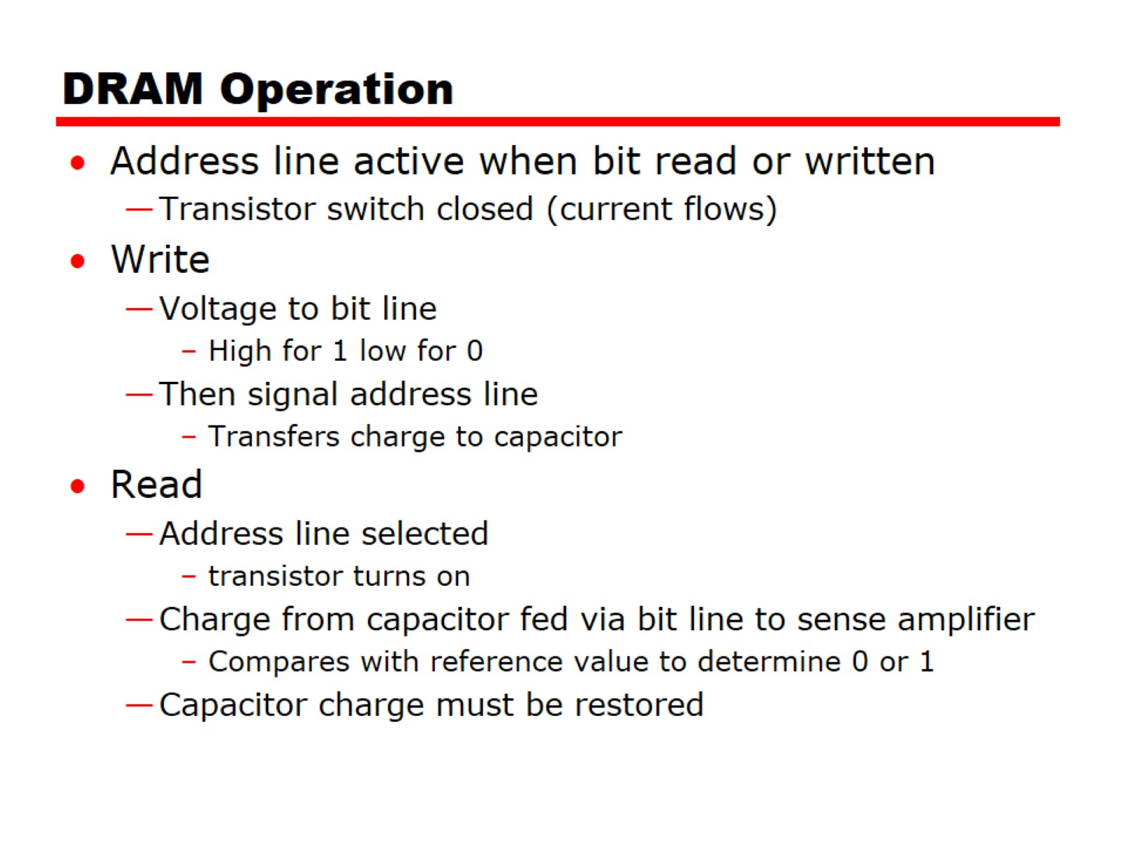
DRAM Operation

Slide 8
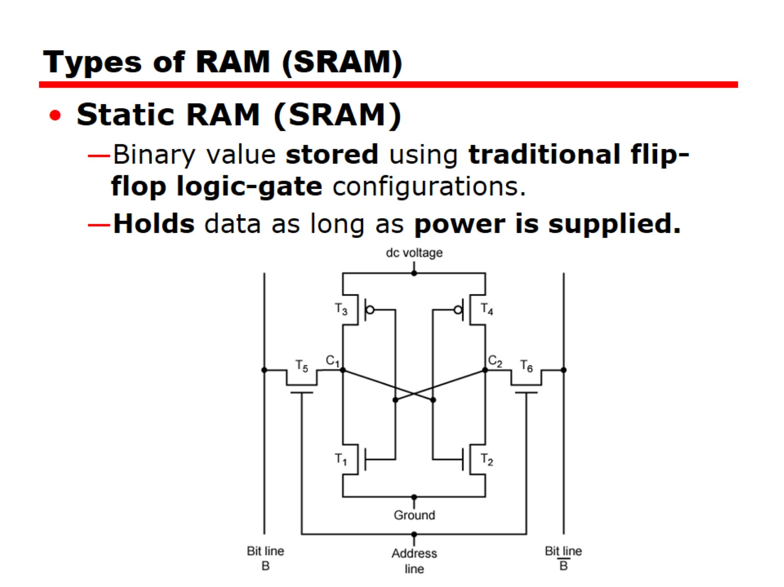
Types of RAM (SRAM)

Slide 9
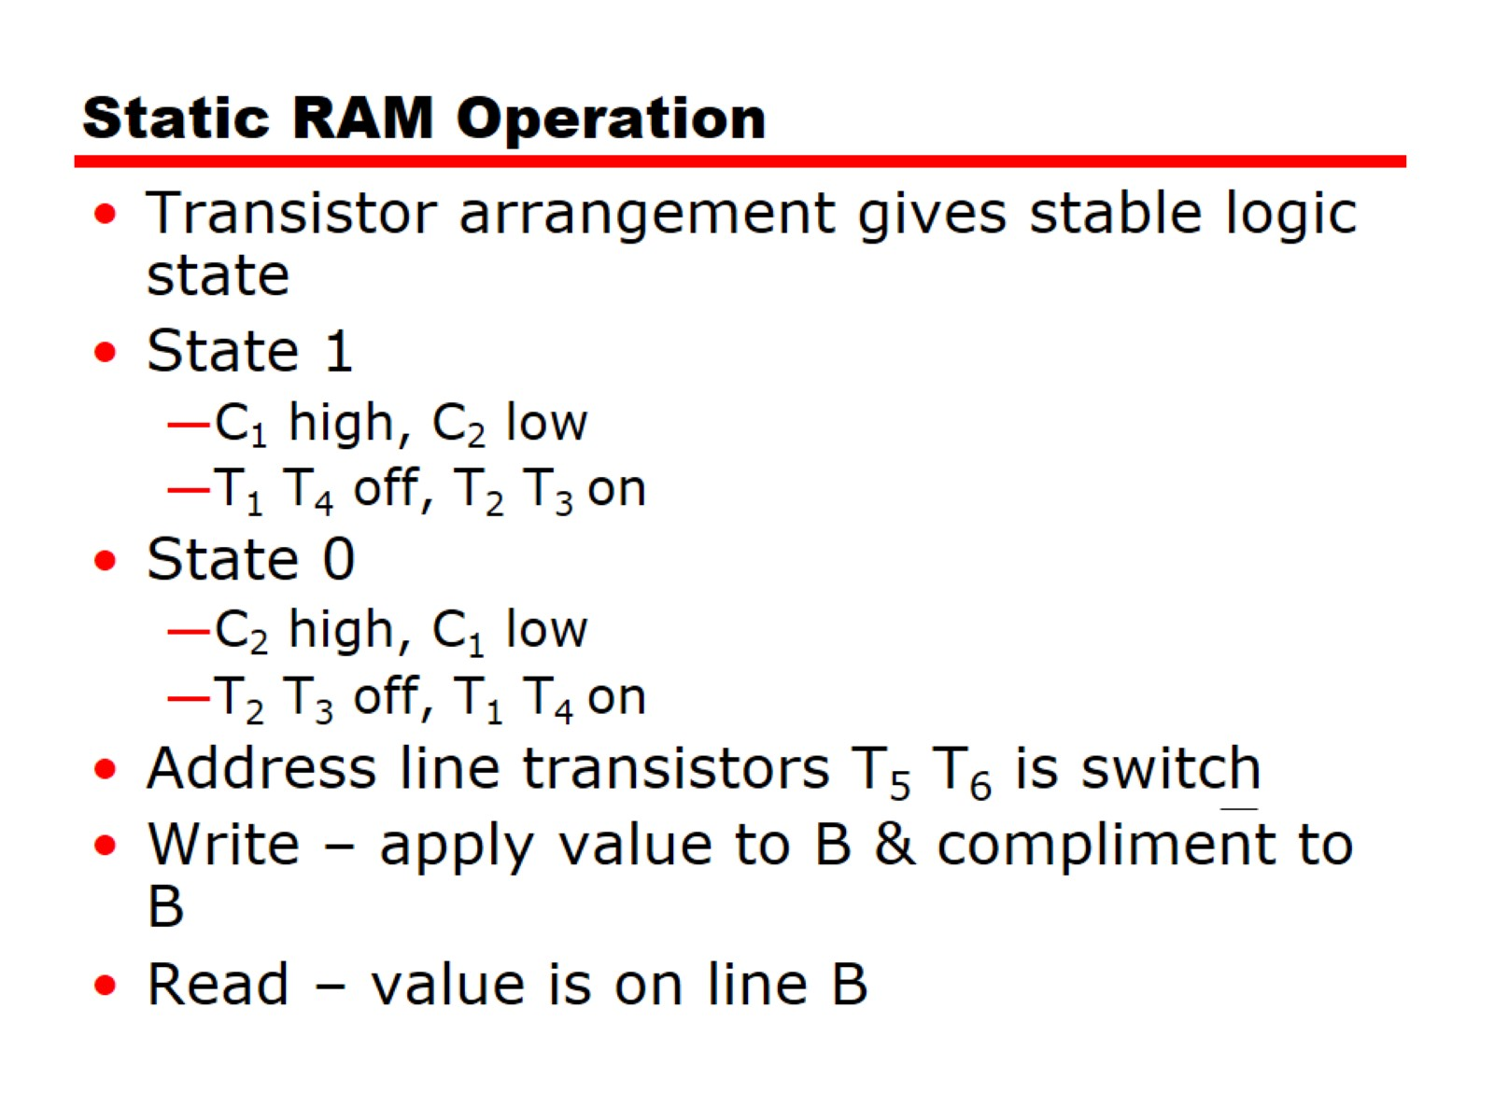
Static RAM Operation

Slide 10
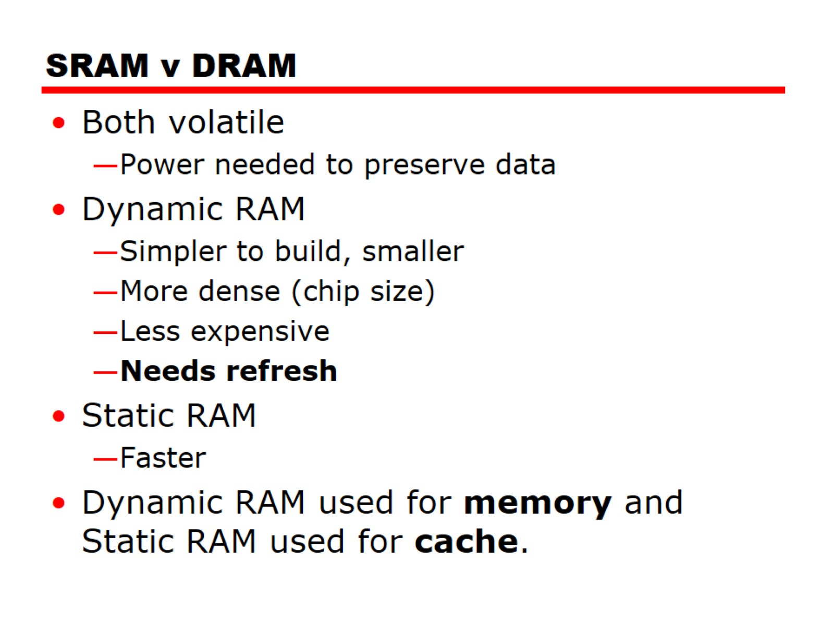
SRAM v DRAM

Slide 11
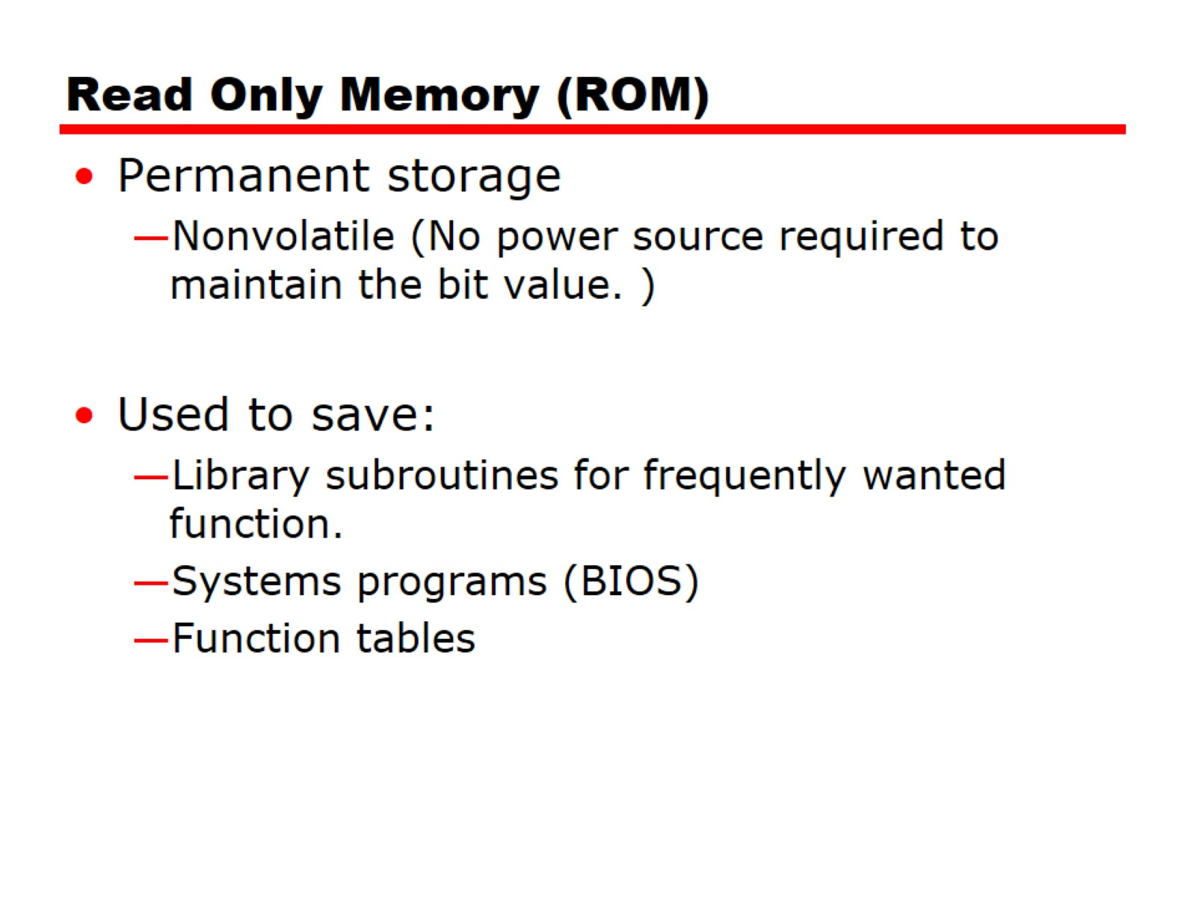
Read Only Memory (ROM)

Slide 12
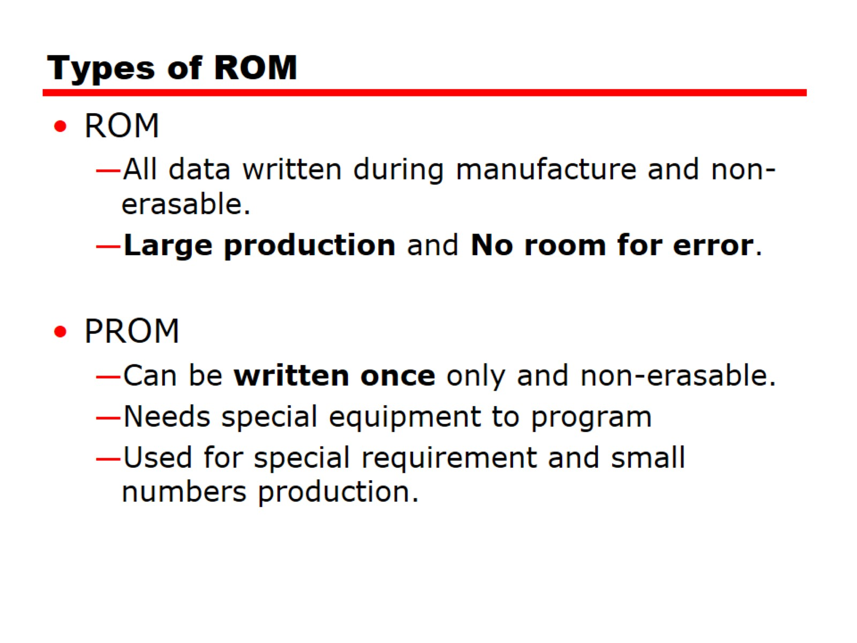
Types of ROM

Slide 13
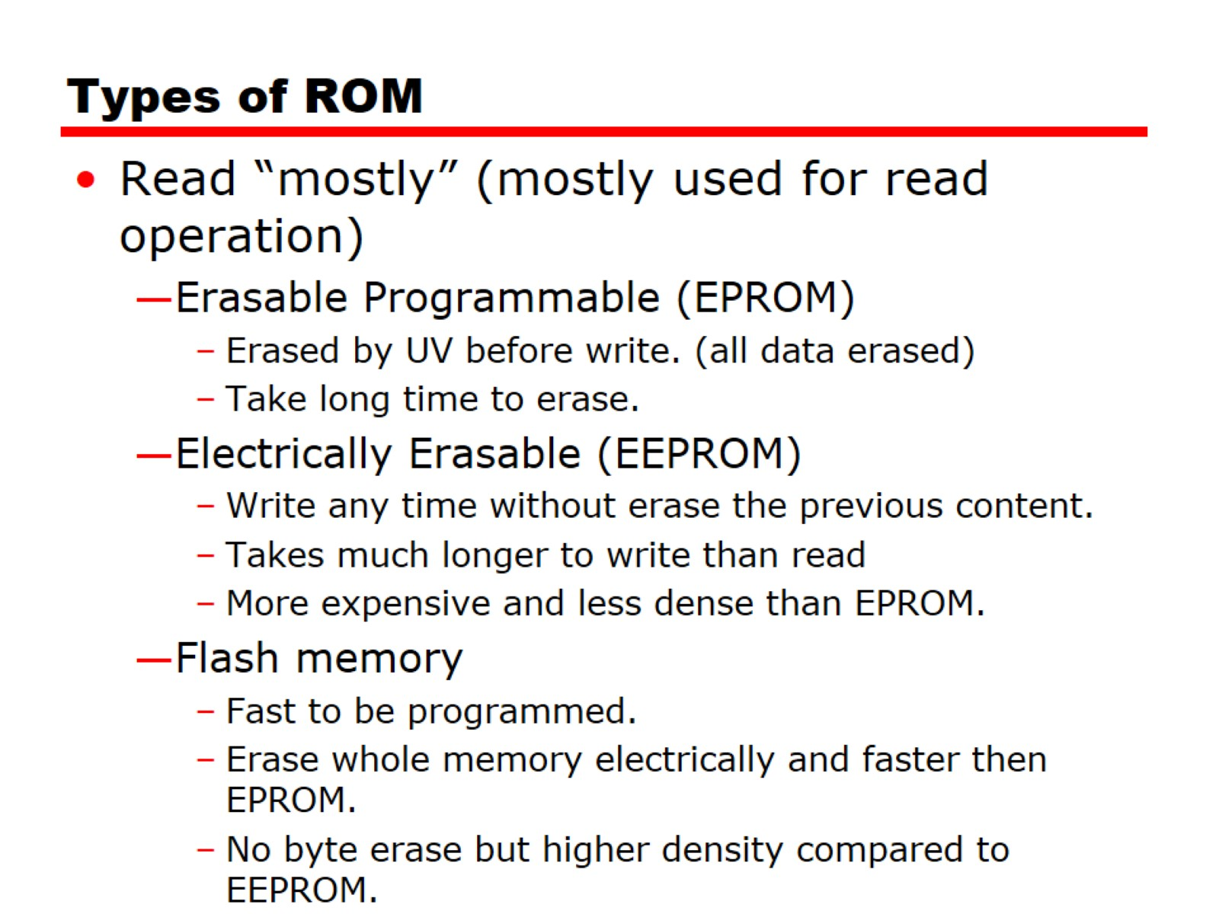
Types of ROM

Slide 14
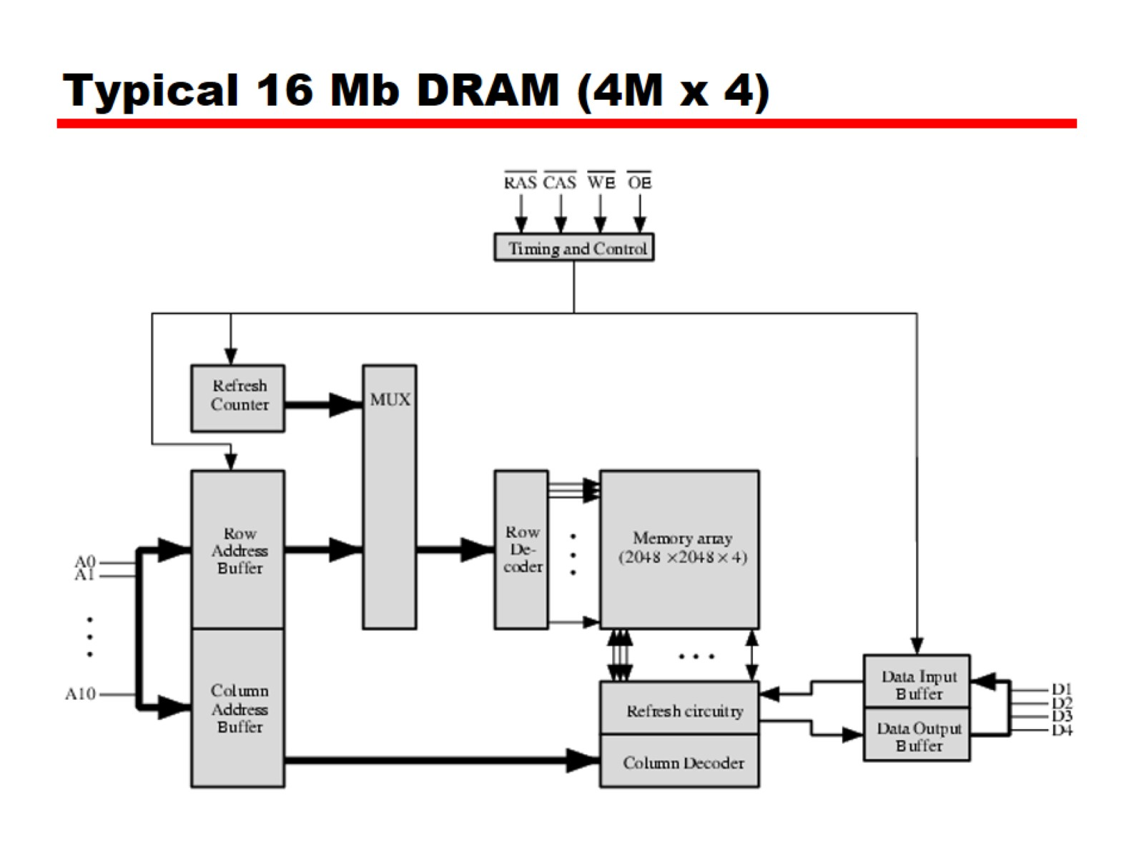
Typical 16 Mb DRAM (4M x 4)

Slide 15
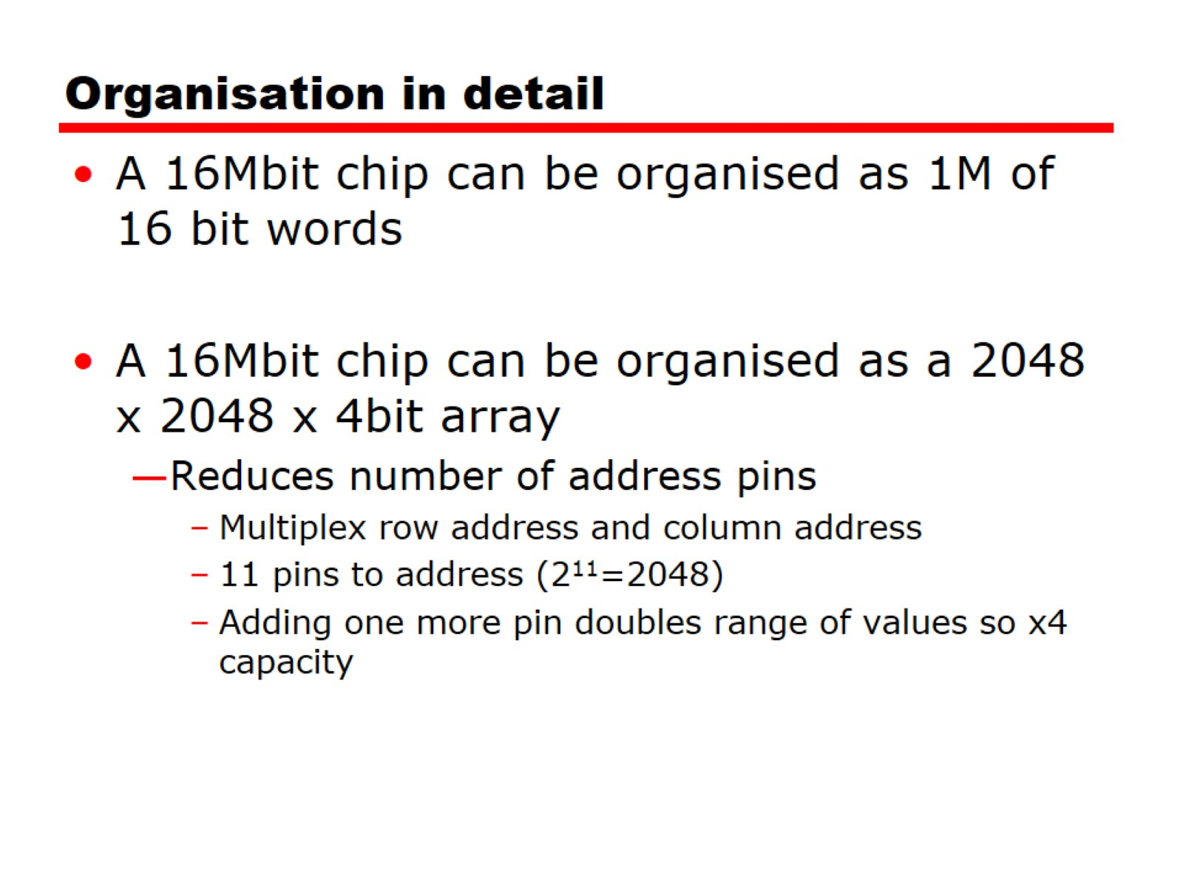
Organisation in detail

Slide 16
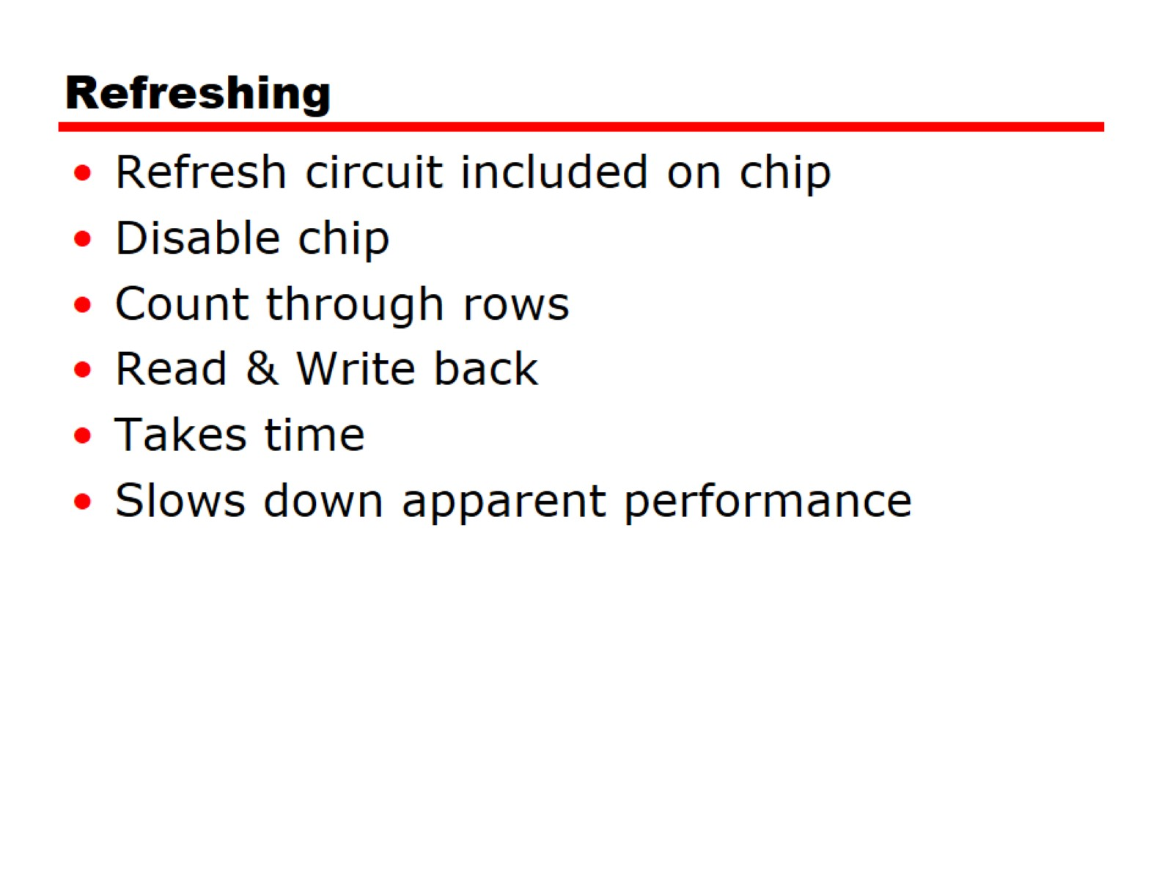
Refreshing

Slide 17
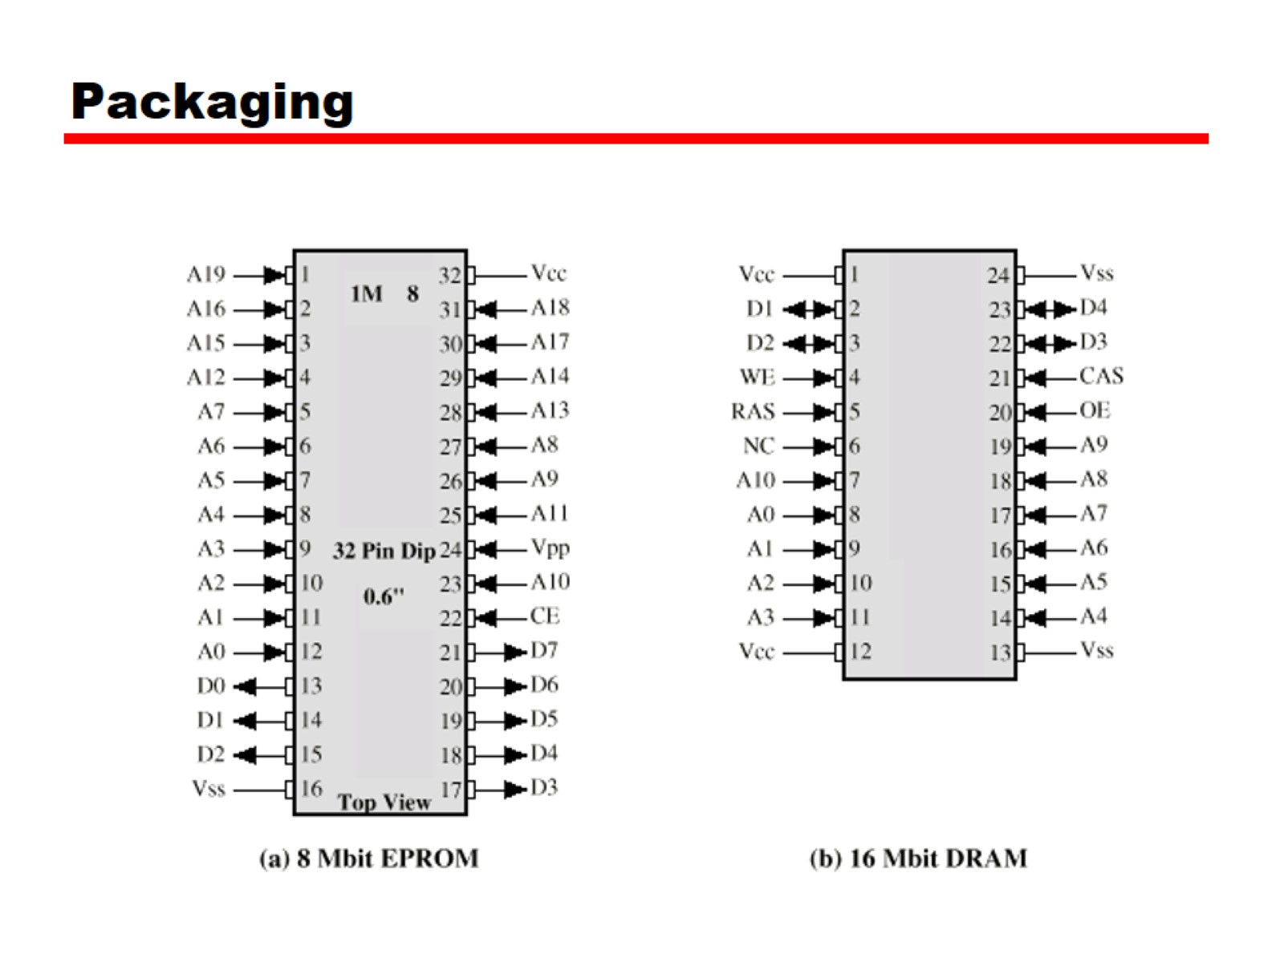
Packaging

Slide 18
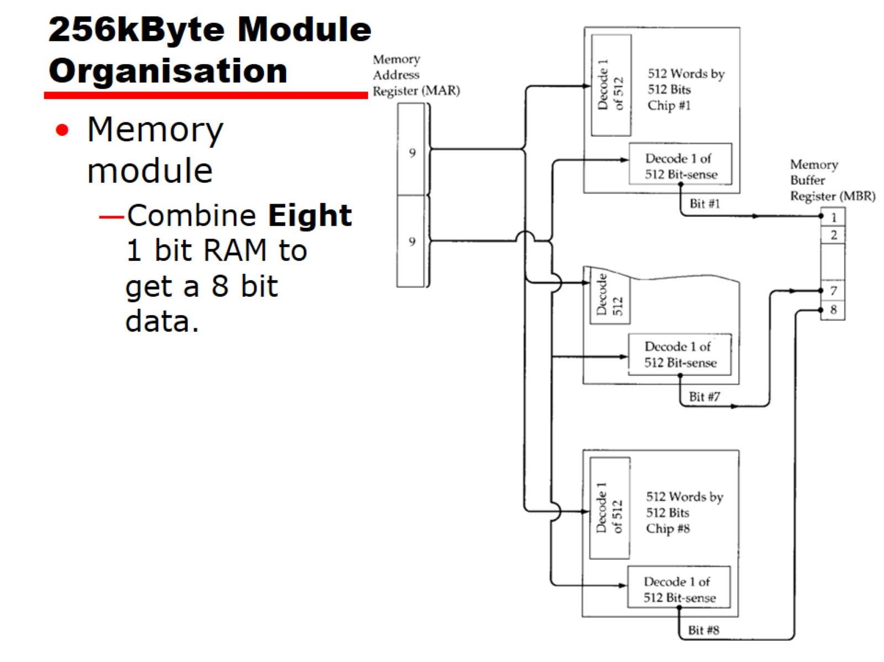
256kByte Module Organisation

Slide 19
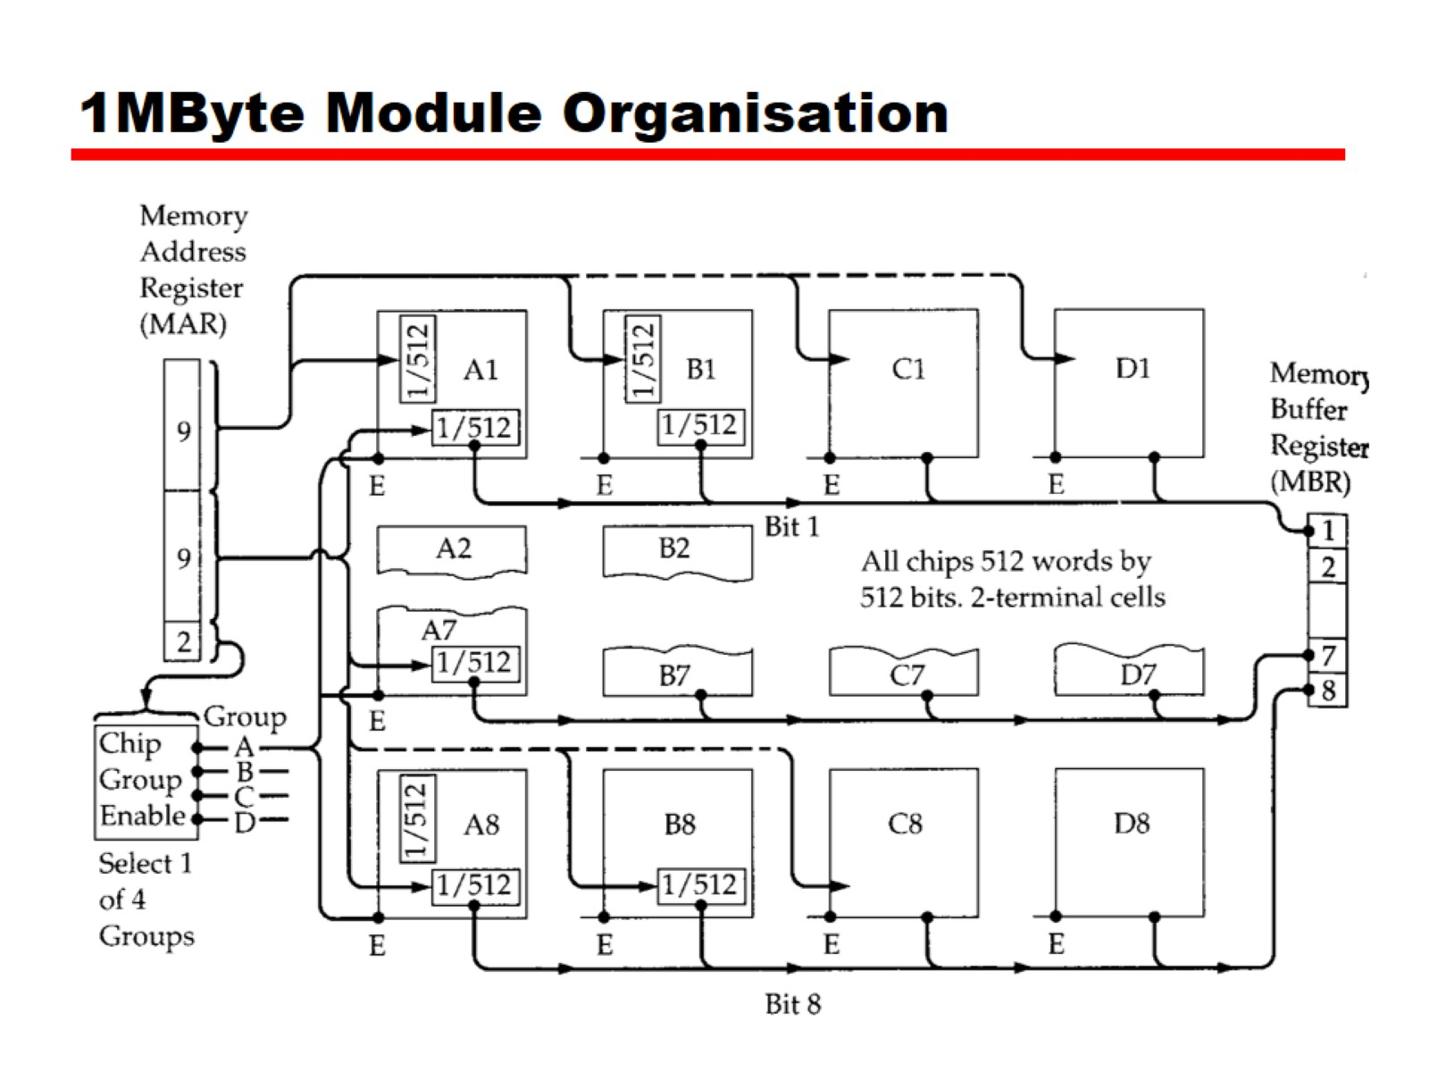
1MByte Module Organisation

Slide 20
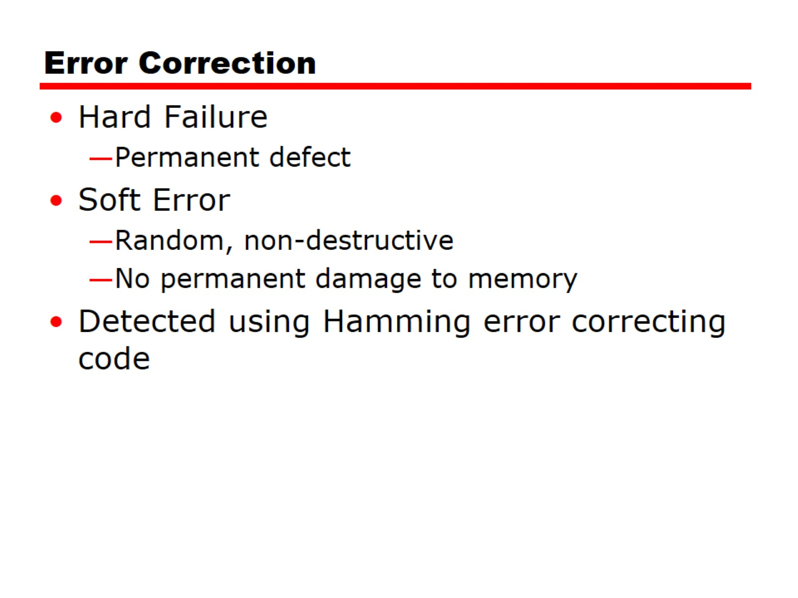
Error Correction

Slide 21
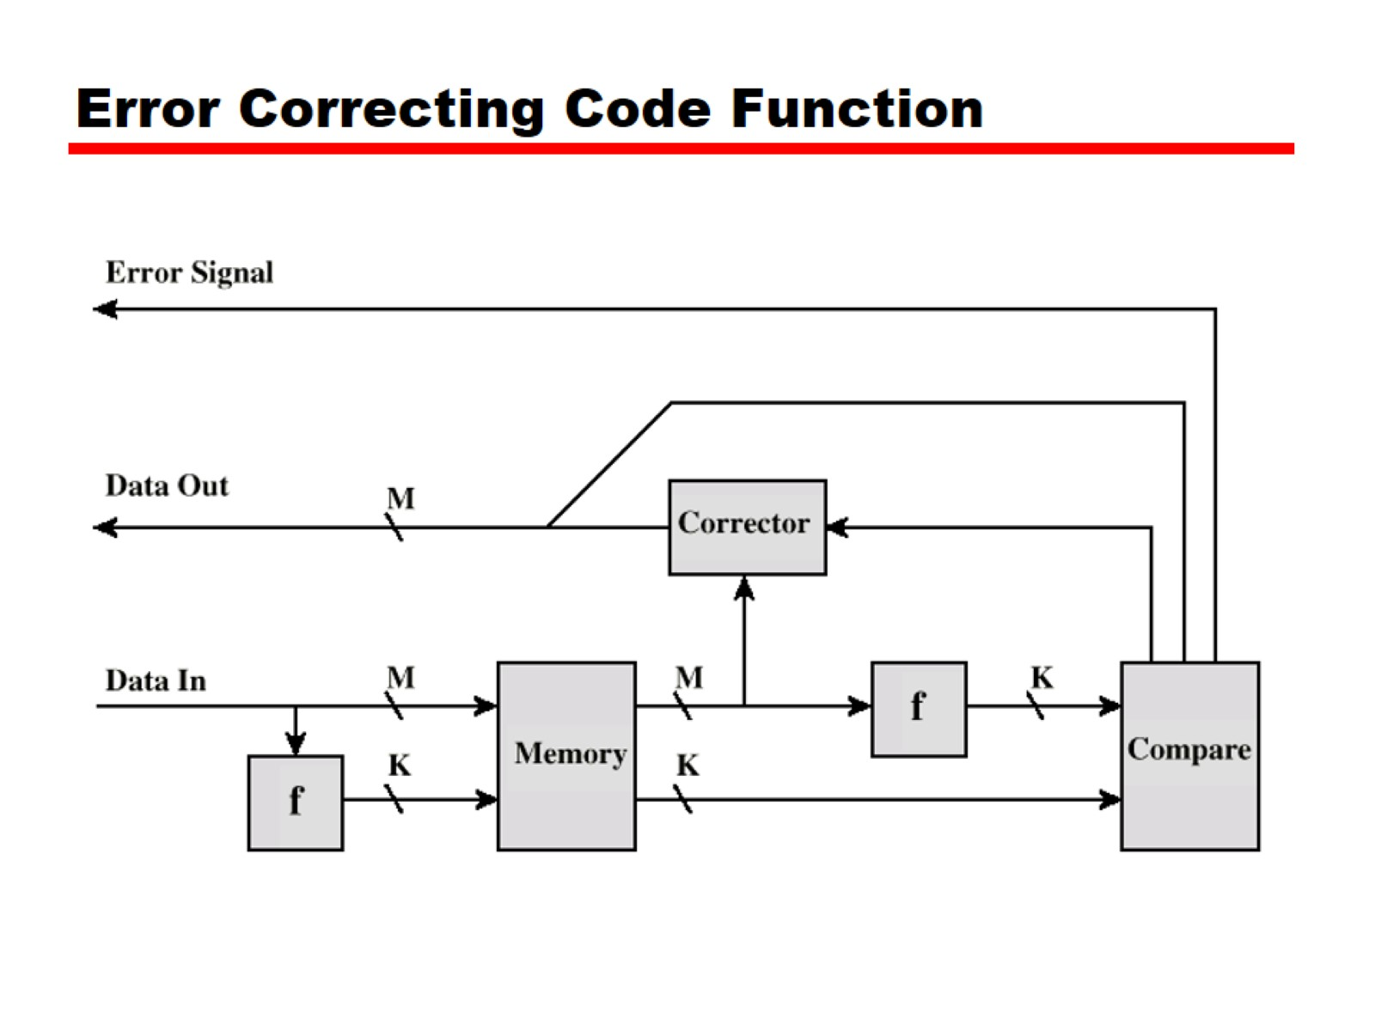
Error Correcting Code Function

Slide 22
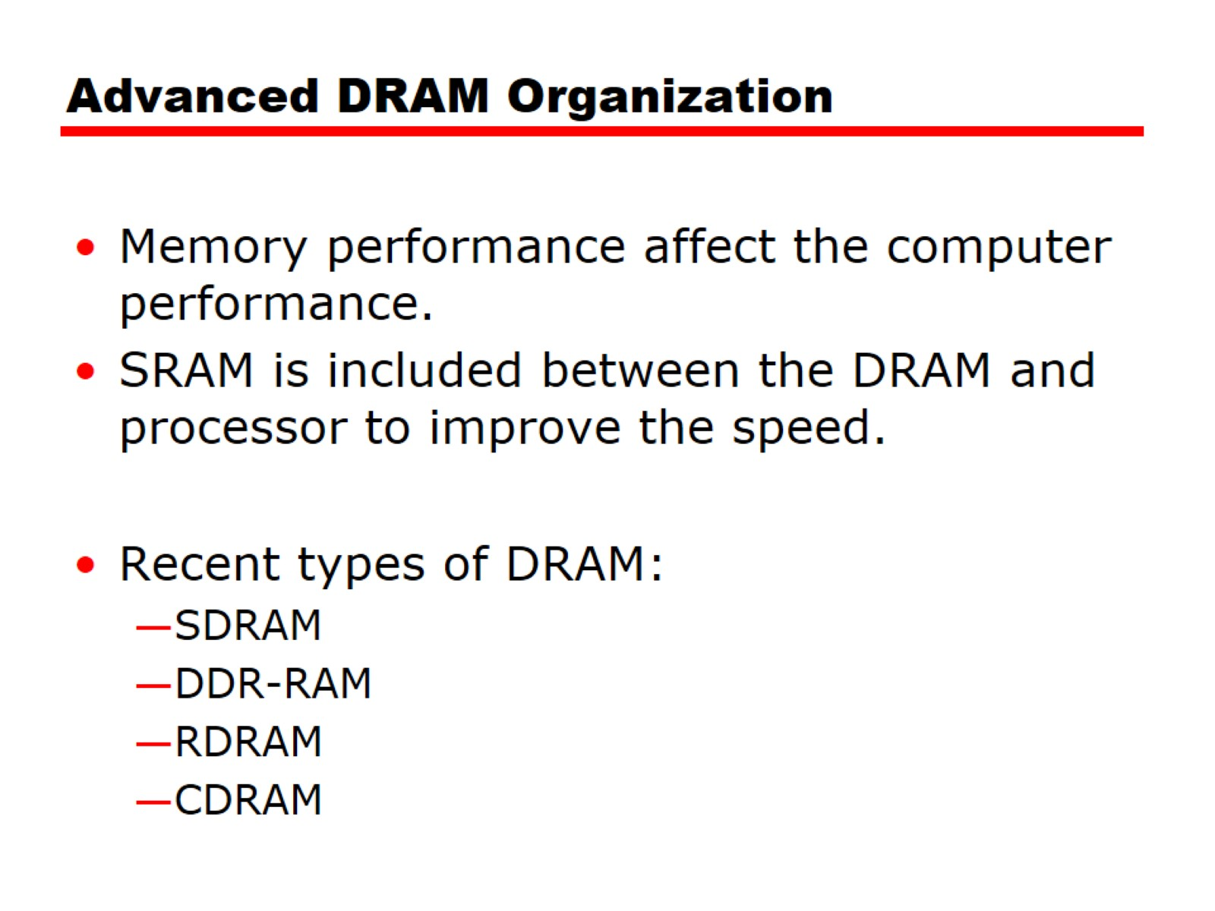
Advanced DRAM Organization

Slide 23
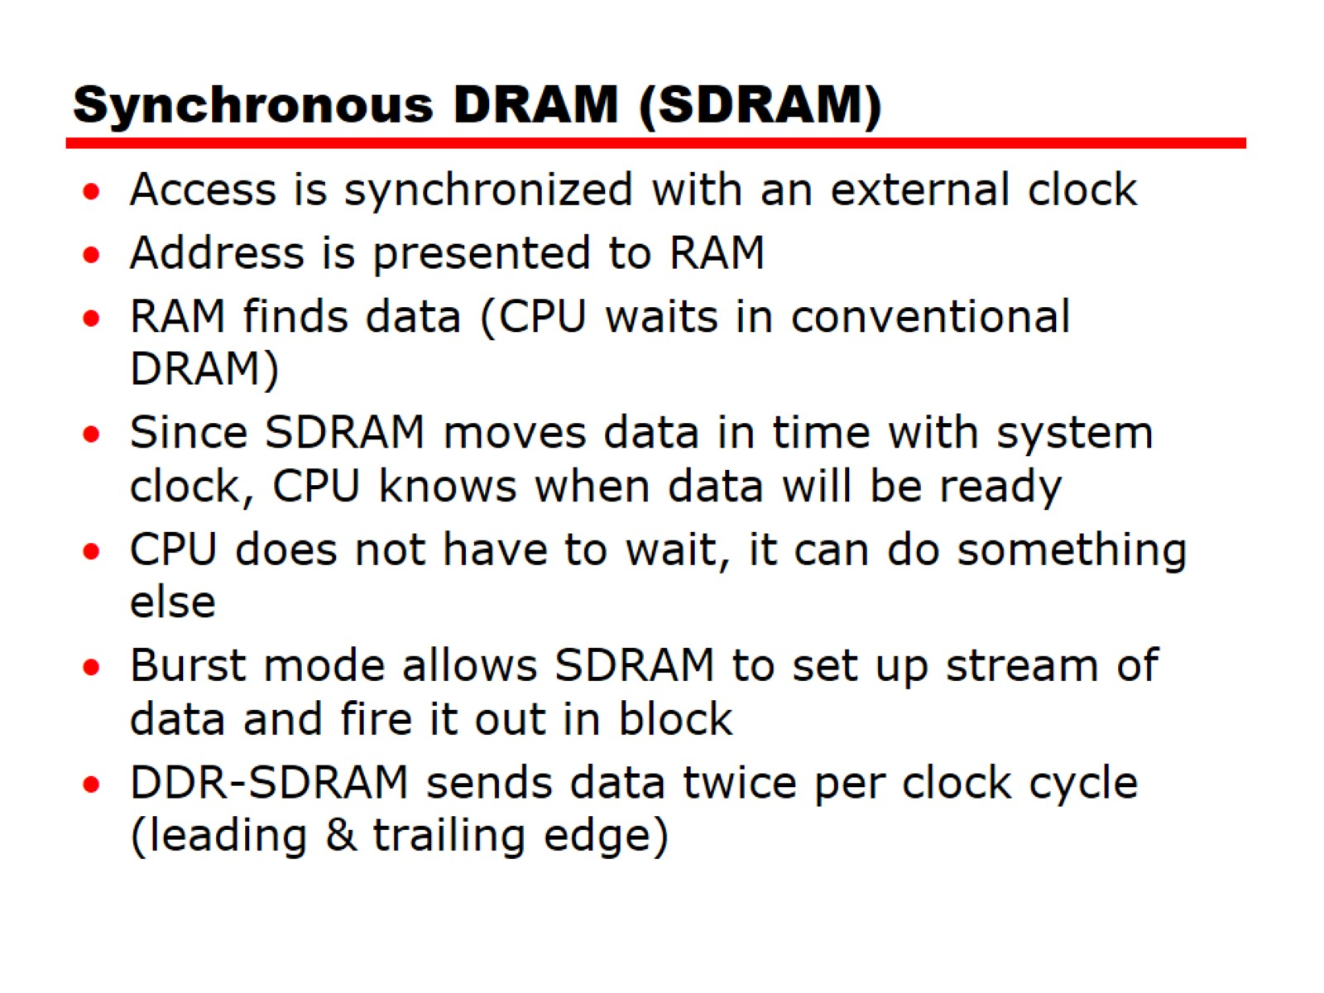
Synchronous DRAM (SDRAM)

Slide 24
256-Mb Synchronous Dynamic RAM (SDRAM)
Notes:
Figure 6.12 shows the internal logic of a typical 256-Mb SDRAM typical
of SDRAM organization.

Slide 25
SDRAM Pin Assignments
A0 to A13 | Address inputs
BA0, BA1 | Bank address lines
CLK | Clock input
CKE | Clock enable
CS | Chip select
RAS | Row address strobe
CAS | Column address strobe
WE | Write enable
DQ0 to DQ7 | Data input/output
DQM | Data mask
Notes:
Table 6.3 defines the various pin assignments.
The SDRAM employs a burst mode to eliminate the address setup time and
row and column line pre-charge time after the first access. In burst mode, a series of
data bits can be clocked out rapidly after the first bit has been accessed. This mode
is useful when all the bits to be accessed are in sequence and in the same row of the
array as the initial access. In addition, the SDRAM has a multiple-bank internal
architecture that improves opportunities for on-chip parallelism.
The mode register and associated control logic is another key feature differentiating
SDRAMs from conventional DRAMs. It provides a mechanism to
customize the SDRAM to suit specific system needs. The mode register specifies
the burst length, which is the number of separate units of data synchronously fed
onto the bus. The register also allows the programmer to adjust the latency between
receipt of a read request and the beginning of data transfer.
The SDRAM performs best when it is transferring large blocks of data serially,
such as for applications like word processing, spreadsheets, and multimedia.

Slide 26
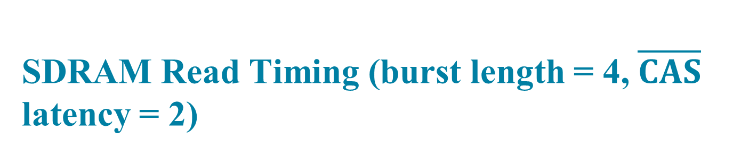
SDRAM Read Timing (burst length = 4, $\overline{CAS}$ latency = 2)
Notes:
Figure 6.13 shows an example of SDRAM operation, using a timing diagram . A
timing diagram shows the signal level on a line as a function of time. By convention,
the binary 1 signal level is depicted as a higher level than that of binary 0. Usually,
binary 0 is the default value. That is, if no data or other signal is being transmitted,
then the level on a line is that which represents binary 0. A signal transition from 0
to 1 is frequently referred to as the signal’s leading edge ; a transition from 1 to 0 is
referred to as a trailing edge . Such transitions are not instantaneous, but this transition
time is usually small compared with the duration of a signal level. For clarity, the
transition is usually depicted as an angled line that exaggerates the relative amount of
time that the transition takes. Signals are sometimes represented in groups, shown as
shaded areas in Figure 6.13. For example, if data are transferred a byte at a time, then
eight lines are required. Generally, it is not important to know the exact value being
transferred on such a group, but rather whether signals are present or not.
For the SDRAM operation in Figure 6.13, the burst length is 4 and the latency
is 2. The burst read command is initiated by having CS and CAS low while holding
RAS and WE high at the rising edge of the clock. The address inputs determine the
starting column address for the burst, and the mode register sets the type of burst
(sequential or interleave) and the burst length (1, 2, 4, 8, full page). The delay from
the start of the command to when the data from the first cell appears on the outputs
is equal to the value of the CAS latency that is set in the mode register.

Slide 27
Double Data Rate SDRAM (DDR SDRAM)
Developed by the JEDEC Solid State Technology Association (Electronic Industries Alliance’s semiconductor-engineering-standardization body)
Numerous companies make DDR chips, which are widely used in desktop computers and servers
DDR achieves higher data rates in three ways:
First, the data transfer is synchronized to both the rising and falling edge of the clock, rather than just the rising edge
Second, DDR uses higher clock rate on the bus to increase the transfer rate
Third, a buffering scheme is used
Notes:
Although SDRAM is a significant improvement on asynchronous RAM, it still
has shortcomings that unnecessarily limit that I/O data rate that can be achieve. To
address these shortcomings a newer version of SDRAM, referred to as double-data-
rate DRAM (DDR RAM) provides several features that dramatically increase
the data rate. DDR DRAM was developed by the JEDEC Solid State Technology
Association, the Electronic Industries Alliance’s semiconductor-engineering-standardization
body. Numerous companies make DDR chips, which are widely used in
desktop computers and servers.
DDR achieves higher data rates in three ways. First, the data transfer is synchronized
to both the rising and falling edge of the clock, rather than just the rising
edge. This doubles the data rate; hence the term double data rate . Second, DDR
uses higher clock rate on the bus to increase the transfer rate. Third, a buffering
scheme is used, as explained subsequently.

Slide 28
DDR Characteristics
 | DDR1 | DDR2 | DDR3 | DDR4
Prefetch buffer (bits) | 2 | 4 | 8 | 8
Voltage level (V) | 2.5 | 1.8 | 1.5 | 1.2
Front side bus data rates (Mbps) | 200—400 | 400—1066 | 800—2133 | 2133—4266
Notes:
JDEC has thus far defined four generations of the DDR technology (Table 6.4).
The initial DDR version makes use of a 2-bit prefetch buffer. The prefetch buffer is
a memory cache located on the SDRAM chip. It enables the SDRAM chip to preposition
bits to be placed on the data bus as rapidly as possible. The DDR I/O bus
uses the same clock rate as the memory chip, but because it can handle two bits per
cycle, it achieves a data rate that is double the clock rate. The 2-bit prefetch buffer
enables the SDRAM chip to keep up with the I/O bus.

Slide 29
DDR Generations
Notes:
To understand the operation of the prefetch buffer, we need to look at it from
the point of view of a word transfer. The prefetch buffer size determines how many
words of data are fetched (across multiple SDRAM chips) every time a column command
is performed with DDR memories. Because the core of the DRAM is much
slower than the interface, the difference is bridged by accessing information in parallel
and then serializing it out the interface through a multiplexor (MUX). Thus,
DDR prefetches two words, which means that every time a read or a write operation
is performed, it is performed on two words of data, and bursts out of, or into, the
SDRAM over one clock cycles on both clock edges for a total of two consecutive
operations. As a result, the DDR I/O interface is twice as fast as the SDRAM core.
Although each new generation of SDRAM results is much greater capacity,
the core speed of the SDRAM has not changed significantly from generation to
generation. To achieve greater data rates than those afforded by the rather modest
increases in SDRAM clock rate, JDEC increased the buffer size. For DDR2, a 4-bit
buffer is used, allowing for words to be transferred in parallel, increasing the effective
data rate by a factor of 4. For DDR3, an 8-bit buffer is used and a factor of 8
speedup is achieved (Figure 6.14).
The downside to the prefetch is that it effectively determines the minimum
burst length for the SDRAMs. For example, it is very difficult to have an efficient
burst length of four words with DDR3’s prefetch of eight. Accordingly, the JDEC
designers chose not to increase the buffer size to 16 bits for DDR4, but rather to
introduce the concept of a bank group [ALLA13]. Bank groups are separate entities
such that they allow a column cycle to complete within a bank group, but that
column cycle does not impact what is happening in another bank group. Thus,
two prefetches of eight can be operating in parallel in the two bank groups. This
arrangement keeps the prefetch buffer size the same as for DDR3, while increasing
performance as if the prefetch is larger.
Figure 6.14 shows a configuration with two bank groups. With DDR4, up to 4
bank groups can be used.

Slide 30
Flash Memory
Used both for internal memory and external memory applications
First introduced in the mid-1980’s
Is intermediate between EPROM and EEPROM in both cost and functionality
Uses an electrical erasing technology like EEPROM
It is possible to erase just blocks of memory rather than an entire chip
Gets its name because the microchip is organized so that a section of memory cells are erased in a single action
Does not provide byte-level erasure
Uses only one transistor per bit so it achieves the high density of EPROM
Notes:
Another form of semiconductor memory is flash memory. Flash memory is used
both for internal memory and external memory applications. Here, we provide a
technical overview and look at its use for internal memory.
First introduced in the mid-1980s, flash memory is intermediate between
EPROM and EEPROM in both cost and functionality. Like EEPROM, flash memory
uses an electrical erasing technology. An entire flash memory can be erased in
one or a few seconds, which is much faster than EPROM. In addition, it is possible
to erase just blocks of memory rather than an entire chip. Flash memory gets its
name because the microchip is organized so that a section of memory cells are
erased in a single action or "flash." However, flash memory does not provide byte-level
erasure. Like EPROM, flash memory uses only one transistor per bit, and so
achieves the high density (compared with EEPROM) of EPROM.

Slide 31
Flash Memory Operation
Notes:
Figure 6.17 illustrates the basic operation of a flash memory. For comparison, Figure
6.17a depicts the operation of a transistor. Transistors exploit the properties of
semiconductors so that a small voltage applied to the gate can be used to control the
flow of a large current between the source and the drain.
In a flash memory cell, a second gate—called a floating gate, because it is insulated
by a thin oxide layer—is added to the transistor. Initially, the floating gate
does not interfere with the operation of the transistor (Figure 6.17b). In this state,
the cell is deemed to represent binary 1. Applying a large voltage across the oxide
layer causes electrons to tunnel through it and become trapped on the floating gate,
where they remain even if the power is disconnected (Figure 6.17c). In this state, the
cell is deemed to represent binary 0. The state of the cell can be read by using external
circuitry to test whether the transistor is working or not. Applying a large voltage
in the opposite direction removes the electrons from the floating gate, returning
to a state of binary 1.
An important characteristic of flash memory is that it is persistent memory,
which means that it retains data when there is no power applied to the memory.
Thus, it is useful for secondary (external) storage, and as an alternative to random
access memory in computers.

Slide 32
Figure 6.18 Flash Memory Structures
Notes:
There are two distinctive types of flash memory, designated as NOR and NAND
(Figure 6.18). In NOR flash memory , the basic unit of access is a bit, referred to as a
memory cell . Cells in NOR flash are connected in parallel to the bit lines so that each
cell can be read/write/erased individually. If any memory cell of the device is turned
on by the corresponding word line, the bit line goes low. This is similar in function to
a NOR logic gate.
NAND flash memory is organized in transistor arrays with 16 or 32 transistors
in series. The bit line goes low only if all the transistors in the corresponding word
lines are turned on. This is similar in function to a NAND logic gate.

Slide 33
Figure 6.19 Kiviat Graphs for Flash Memory
Notes:
Although the specific quantitative values of various characteristics of NOR
and NAND are changing year by year, the relative differences between the two
types has remained stable. These differences are usefully illustrated by the Kiviat
graphs shown in Figure 6.19.
NOR flash memory provides high-speed random access. It can read and write
data to specific locations, and can reference and retrieve a single byte. NAND reads
and writes in small blocks. NAND provides higher bit density than NOR and greater
write speed. NAND flash does not provide a random-access external address bus so
the data must be read on a blockwise basis (also known as page access), where each
block holds hundreds to thousands of bits.
For internal memory in embedded systems, NOR flash memory has traditionally
been preferred. NAND memory has made some inroads, but NOR remains the
dominant technology for internal memory. It is ideally suited for microcontrollers
where the amount of program code is relatively small and a certain amount of application
data does not vary. For example, the flash memory in Figure 1.16 is NOR
memory.
NAND memory is better suited for external memory, such as USB flash
drives, memory cards (in digital cameras, MP3 players, etc.), and in what are known
as solid-state disks (SSDs). We discuss SSDs in Chapter 7.

Slide 34
Figure 6.20 Nonvolatile RAM within the Memory Hierarchy
Notes:
The traditional memory hierarchy has consisted of three levels (Figure 6.20):
■ Static RAM (SRAM): SRAM provides rapid access time, but is the most expensive
and the least dense (bit density). SRAM is suitable for cache memory.
■ Dynamic RAM (DRAM): Cheaper, denser, and slower than SRAM, DRAM
has traditionally been the choice off-chip main memory.
■ Hard disk: A magnetic disk provides very high bit density and very low cost
per bit, with relatively slow access times. It is the traditional choice for external
storage as part of the memory hierarchy.
Into this mix, as we have seen, as been added flash memory. Flash memory has the
advantage over traditional memory that it is nonvolatile. NOR flash is best suited
to storing programs and static application data in embedded systems, while NAND
flash has characteristics intermediate between DRAM and hard disks.
Over time, each of these technologies has seen improvements in scaling: higher
bit density, higher speed, lower power consumption, and lower cost. However, for
semiconductor memory, it is becoming increasingly difficult to continue the pace of
improvement [ITRS14].
Recently, there have been breakthroughs in developing new forms of nonvolatile
semiconductor memory that continue scaling beyond flash memory. The
most promising technologies are spin-transfer torque RAM (STT-RAM), phasechange
RAM (PCRAM), and resistive RAM (ReRAM) ([ITRS14], [GOER12]).
All of these are in volume production. However, because NAND Flash and to some
extent NOR Flash are still dominating the applications, these emerging memories
have been used in specialty applications and have not yet fulfilled their original
promise to become dominating mainstream high-density nonvolatile memory. This
is likely to change in the next few years.
Figure 6.20 shows how these three technologies are likely to fit into the memory
hierarchy.

Slide 35
Figure 6.21 Nonvolatile RAM Technologies
Notes:
STT-RAM is a new type of Magnetic RAM (MRAM), which features non-volatility,
fast writing/reading speed <10ns), and high programming endurance (>10¹⁵cycles)
and zero standby power [KULT13]. The storage capability or programmability of
MRAM arises from magnetic tunneling junction (MTJ), in which a thin tunneling
dielectric is sandwiched between two ferromagnetic layers. One ferromagnetic layer
(pinned or reference layer) is designed to have its magnetization pinned, while the
magnetization of the other layer (free layer) can be flipped by a write event. An MTJ
has a low (high) resistance if the magnetizations of the free layer and the pinned layer
are parallel (anti-parallel). In first-generation MRAM design, the magnetization of the
free layer is changed by the current-induced magnetic field. In STT-RAM, a new write
mechanism, called polarization-current-induced magnetization switching, is introduced.
For STT-RAM, the magnetization of the free layer is flipped by the electrical
current directly. Because the current required to switch an MTJ resistance state is proportional
to the MTJ cell area, STT-RAM is believed to have a better scaling property
than the first-generation MRAM. Figure 6.21a illustrates the general configuration.
STT-RAM is a good candidate for either cache or main memory.
Phase-change RAM (pcram) is the most mature or the new technologies, with an extensive
technical literature ([RAOU09], [ZHOU09], [LEE10]).
PCRAM technology is based on a chalcogenide alloy material, which is similar
to those commonly used in optical storage media (compact discs and digital versatile
discs). The data storage capability is achieved from the resistance differences
between an amorphous (high-resistance) and a crystalline (low-resistance) phase
of the chalcogenide-based material. In SET operation, the phase change material is
crystallized by applying an electrical pulse that heats a significant portion of the cell
above its crystallization temperature. In RESET operation, a larger electrical current
is applied and then abruptly cut off in order to melt and then quench the material,
leaving it in the amorphous state. Figure 6.21b illustrates the general configuration.
PCRAM is a good candidate to replace or supplement DRAM for main
memory.
ReRAM (also known as RRAM) works by creating resistance rather than directly
storing charge. An electric current is applied to a material, changing the resistance
of that material. The resistance state can then be measured and a 1 or 0 is read as
the result. Much of the work done on ReRAM to date has focused on finding appropriate
materials and measuring the resistance state of the cells. ReRAM designs
are low voltage, endurance is far superior to flash memory, and the cells are much
smaller—at least in theory. Figure 6.21c shows one ReRam configuration.
ReRAM is a good candidate to replace or supplement both secondary storage
and main memory.

